Slide 1
Group4 eStreaming
By Philip Charles, Caleb Busch, Robert Antenorcruz, Djiedjom Ange Lionel Gbonkou, Chetanya Sharma, Sammi Wong

Slide 2
Philip Charles task
Project Management Tools – To do List and Gantt Planner
Planning of the workflow for the Project
Distribution of tasks among group members
Account Subject Area

Slide 3
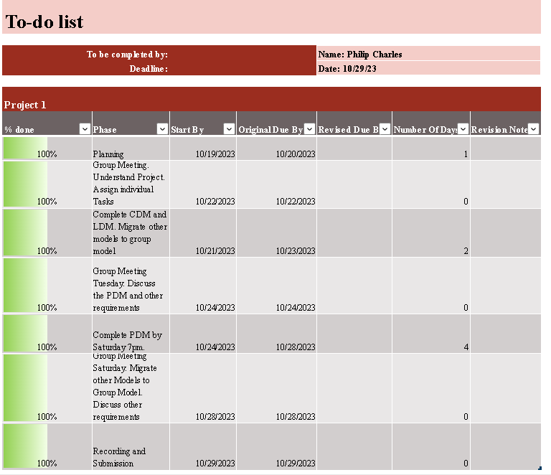
To-Do List (Philip Charles)

Slide 4
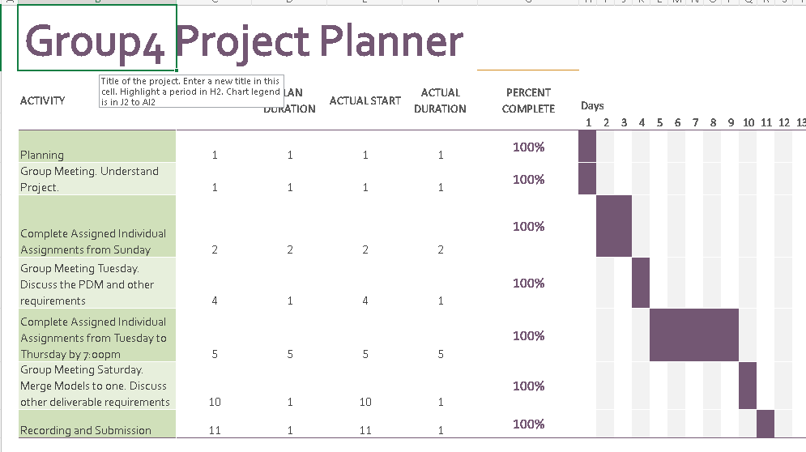
Gantt Project Planner

Slide 5
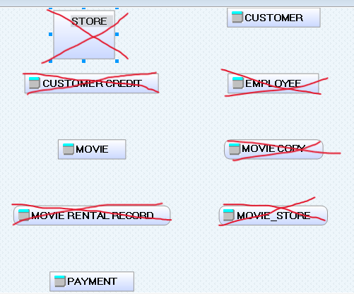
Omitted Objects

Slide 6
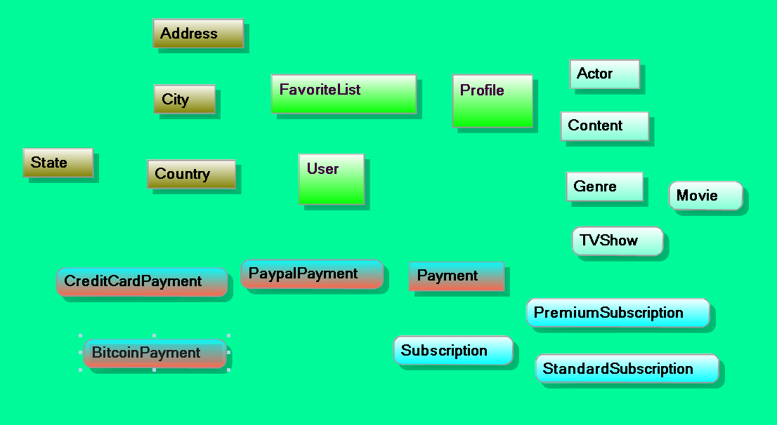
Critical and Fundamental Business Objects

Slide 7
Business Rules for Account Subject Area
A USER can have one to many PROFILE(S)
A PROFILE belongs to only one USER
A PROFILE can have zero or one FAVORITELIST
A FAVORITELIST belongs to only one PROFILE
A FAVORITELIST contains zero or many CONTENT
A CONTENT belongs to zero or many FAVORITELIST(S)

Slide 8
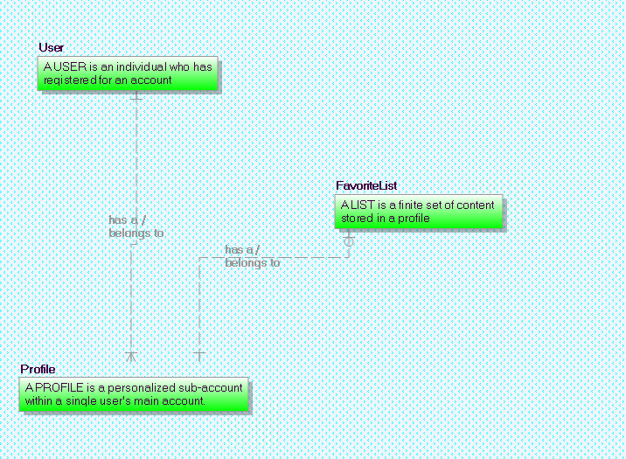
Account Subject Area (CDM)

Slide 9
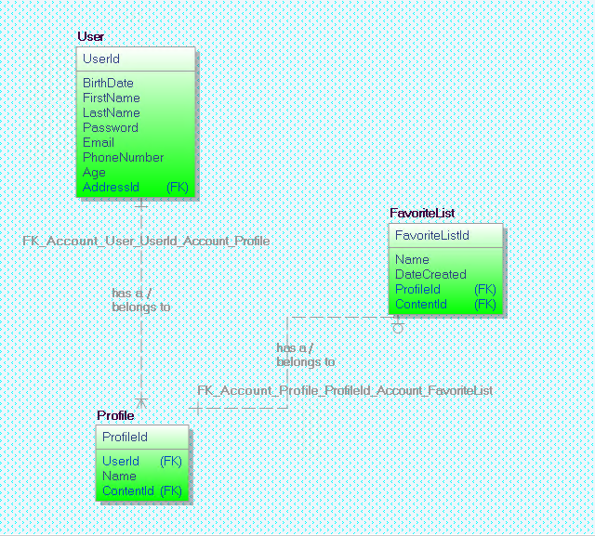
Account Subject Area (LDM)

Slide 10
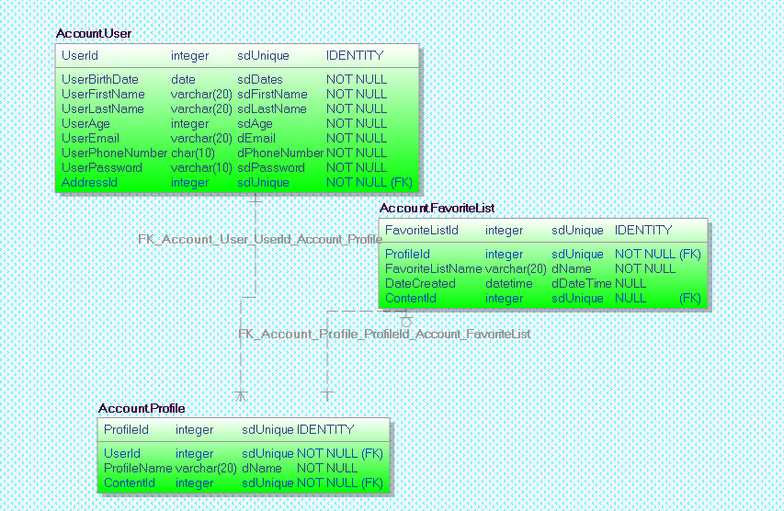
Account Subject Area PDM

Slide 11
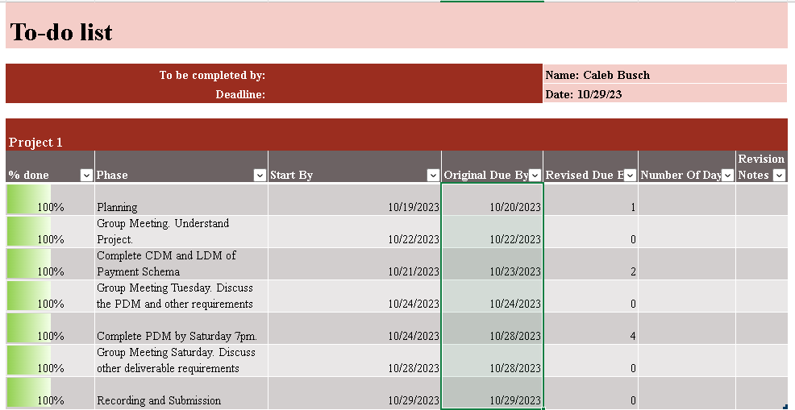
To-do List(Caleb Busch)

Slide 12
Caleb Busch's Tasks
Transactions Subject Area
CDM, LDM, PDM
Built defaults, constraints, and subdomains for the Transactions attributes
Using template-name architecture

Slide 13
Business Rules for Transactions Subject Area
A PAYMENT is made by zero or one USER(s)
A USER can make zero, one, or many PAYMENT(s)
Each PAYMENT must contain exactly one PAYMENTTYPE
A PAYMENT can be of type BITCOINPAYMENT, PAYPALPAYMENT, or CREDITCARDPAYMENT

Slide 14
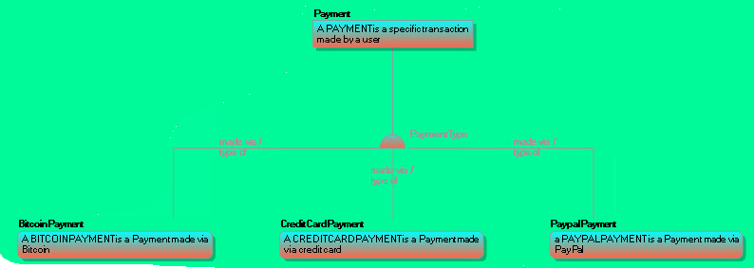
Transactions Subject Area [CDM]

Slide 15
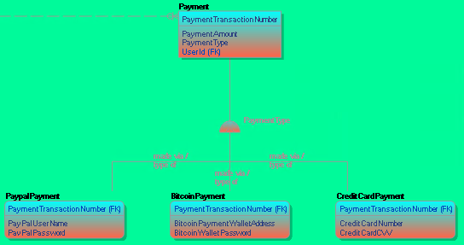
Transactions Subject Area [LDM]

Slide 16
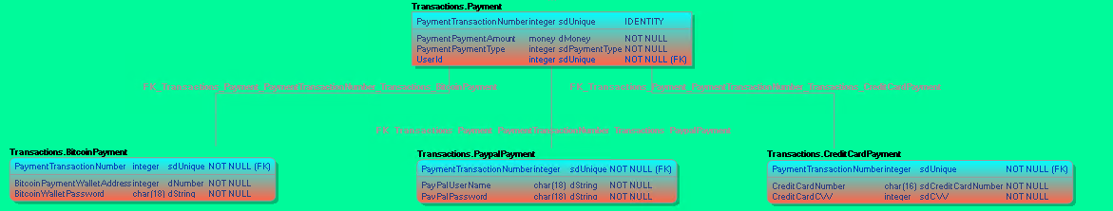
Transactions Subject Area [PDM]
FK_SchemaName_ParentTable_ColumnName(primary key)_SchemaName_ChildTable

Slide 17
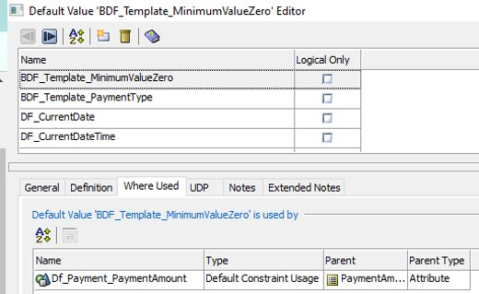
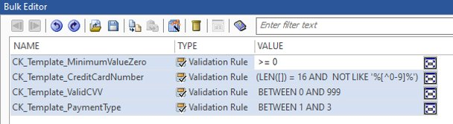
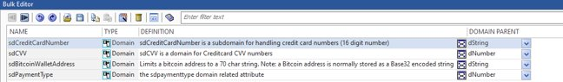
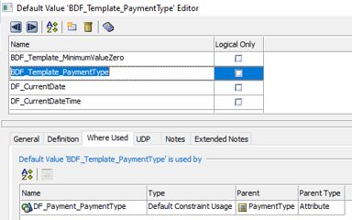
Transaction's Defaults, Constraints, and Domains

Slide 18
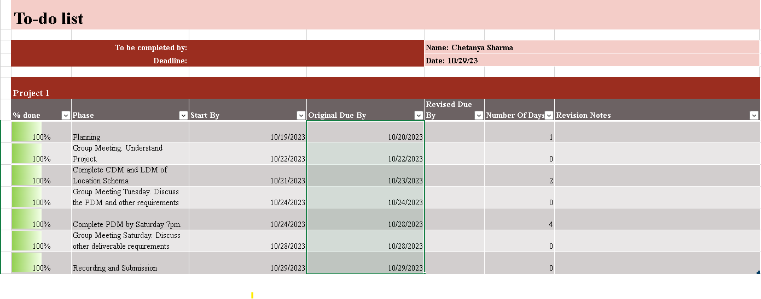
To-do List (Chetanya Sharma)

Slide 19
Chetanya Sharma's Task
Location subject Area
Made the location schema for cdm ldm and pdm.
Built defaults , constrains , colored shemes and made theme for using colored background for models.

Slide 20
Business rules for Location subject area
Each users can have exactly one address . User can have one to one with address .
City to address is on to many relationships.
It can have multiple addresses with one city .
State and country also have one to may relationships with address
State to country have many to one
State to city have one to may relationships .

Slide 21
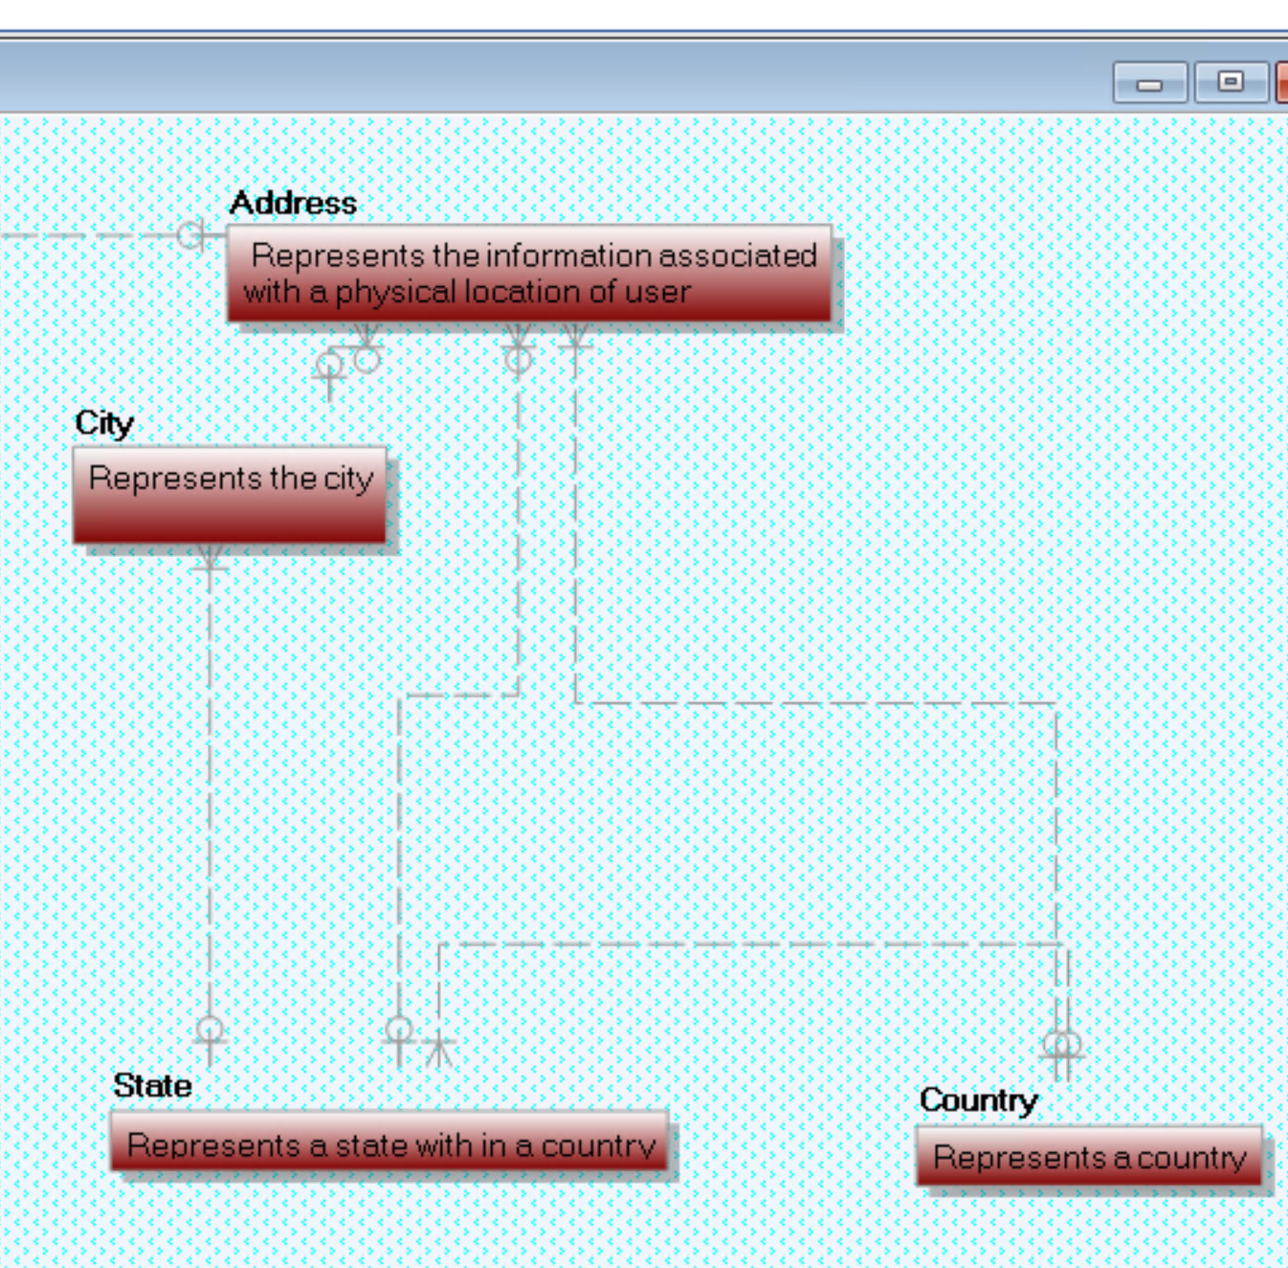
Location subject area (CDM)

Slide 22
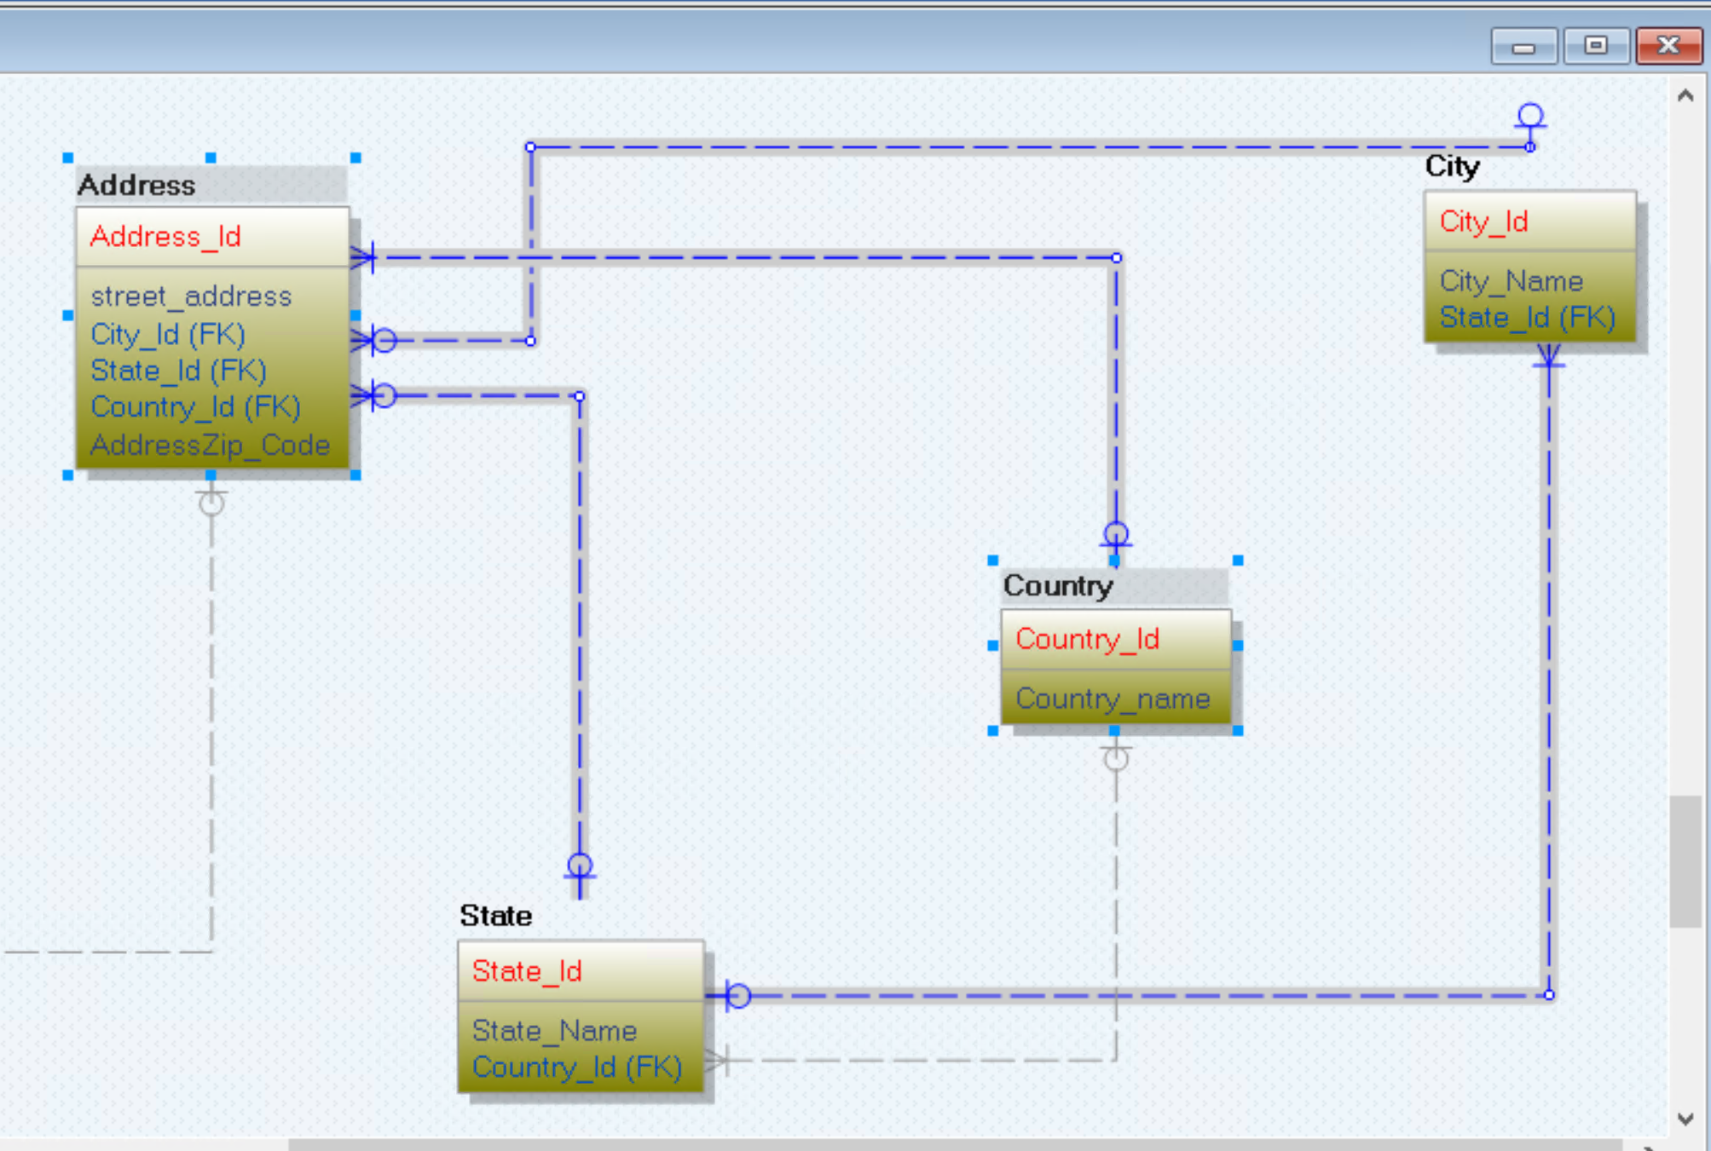
Location subject area (LDM)

Slide 23
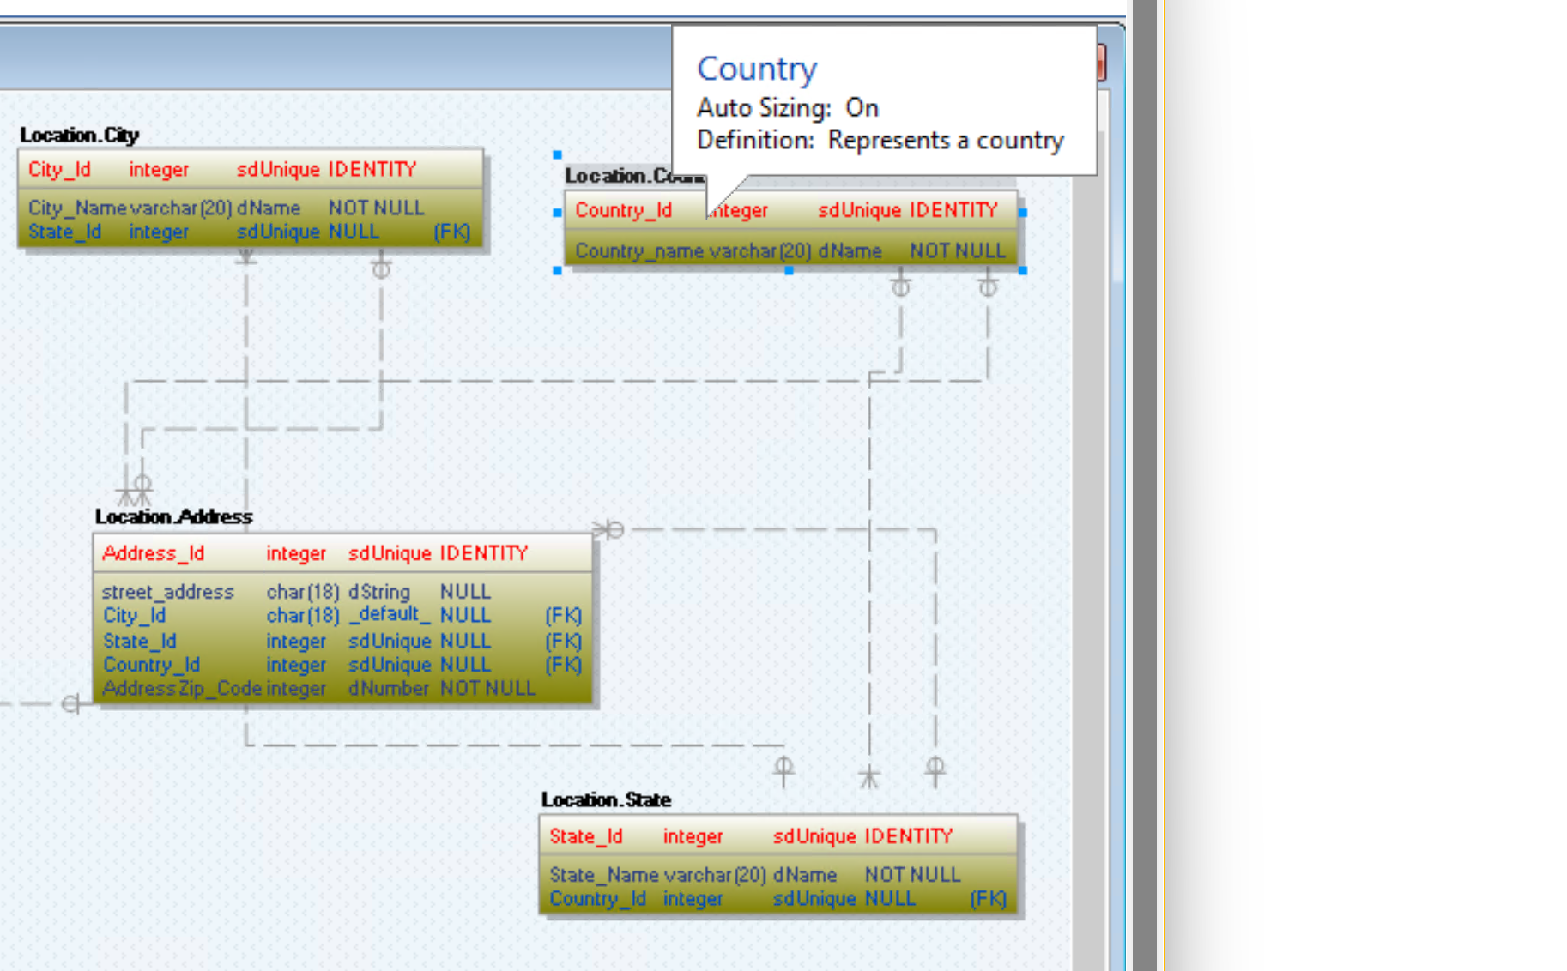
Location subject area (PDM)

Slide 24
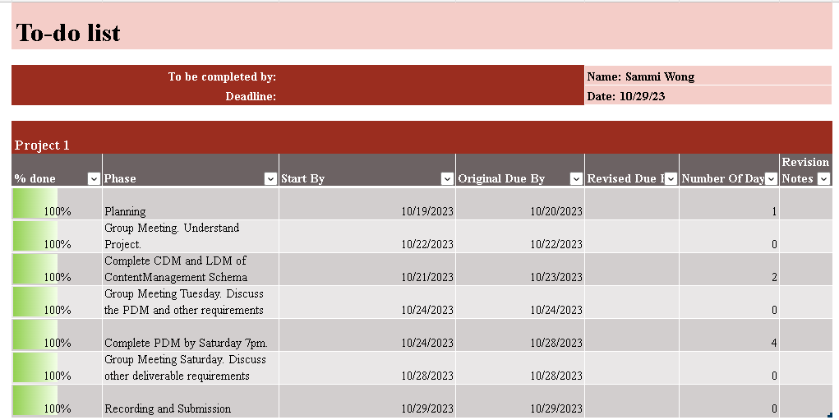
To-do List (Sammi Wong)

Slide 25
Sammi Wong task
Content Management Subject Area

Slide 26
Business Rules for Content Management Subject Area
CONTENT is a supertype that includes a TVSHOW and MOVIE subtypes
A TVSHOW can have many ACTOR
An ACTOR can act in many TVSHOW
A TVSHOW can have many GENRE
A GENRE can be part of many TVSHOW
A MOVIE can have many ACTOR
An ACTOR can act in many MOVIE
A MOVIE can have many GENRE
A GENRE can be part of many MOVIE

Slide 27
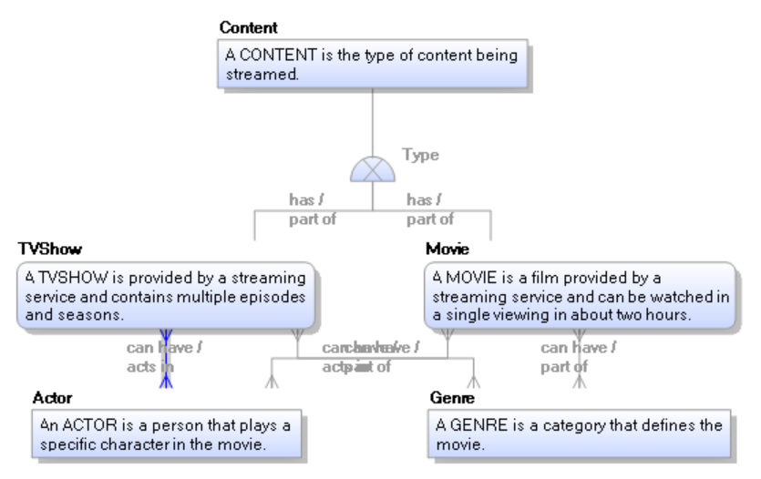
Content Management Subject Area (CDM)

Slide 28
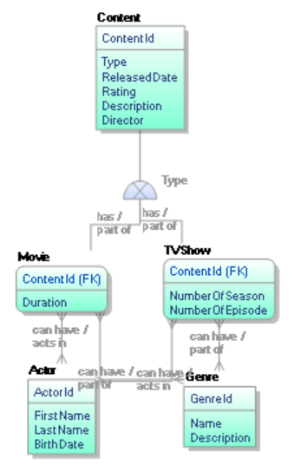
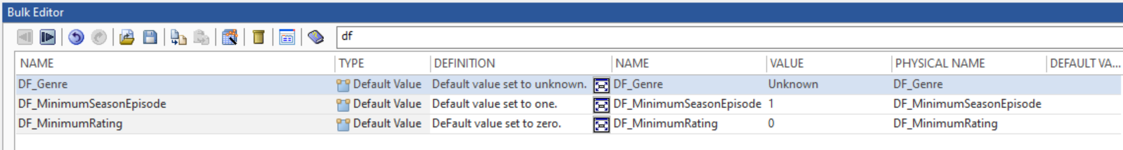
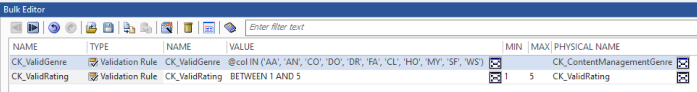
Content Management Subject Area (LDM)

Slide 29
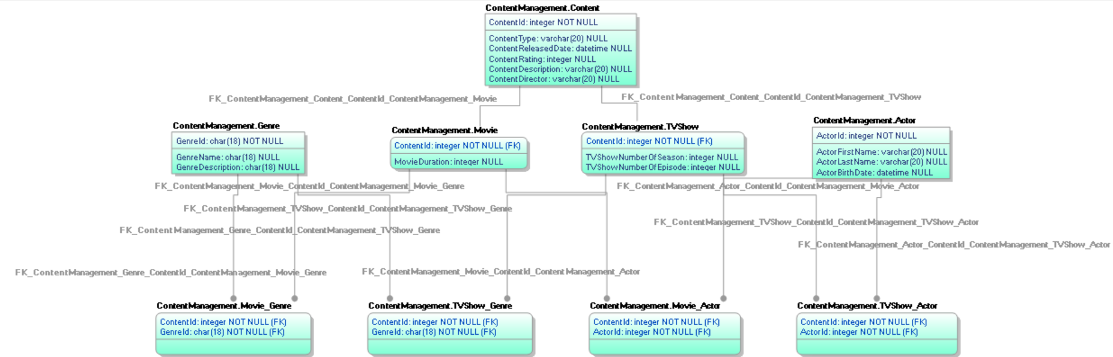
Content Management Subject Area (PDM)

Slide 30
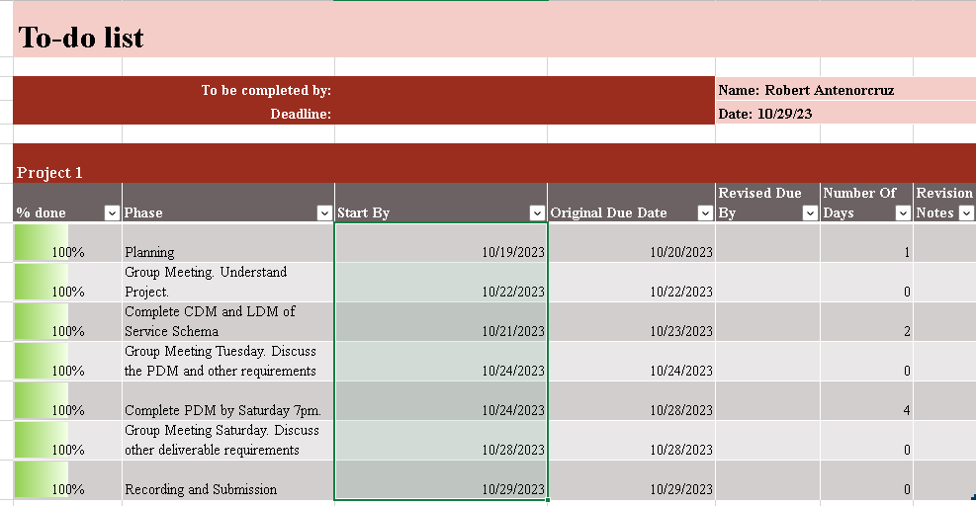
To-do List (Robert Antenorcruz)

Slide 31
Robert Antenorcruz's Tasks
Service subject area

Slide 32
Business rules for Service subject area
A SUBSCRIPTION belongs to a USER
A PREMIUMSUBSCRIPTION is a type of SUBSCRIPTION
A STANDARDSUBCRIPTION is a type of SUBSCRIPTION
A USER can only have zero or one SUBSCRIPTION

Slide 33
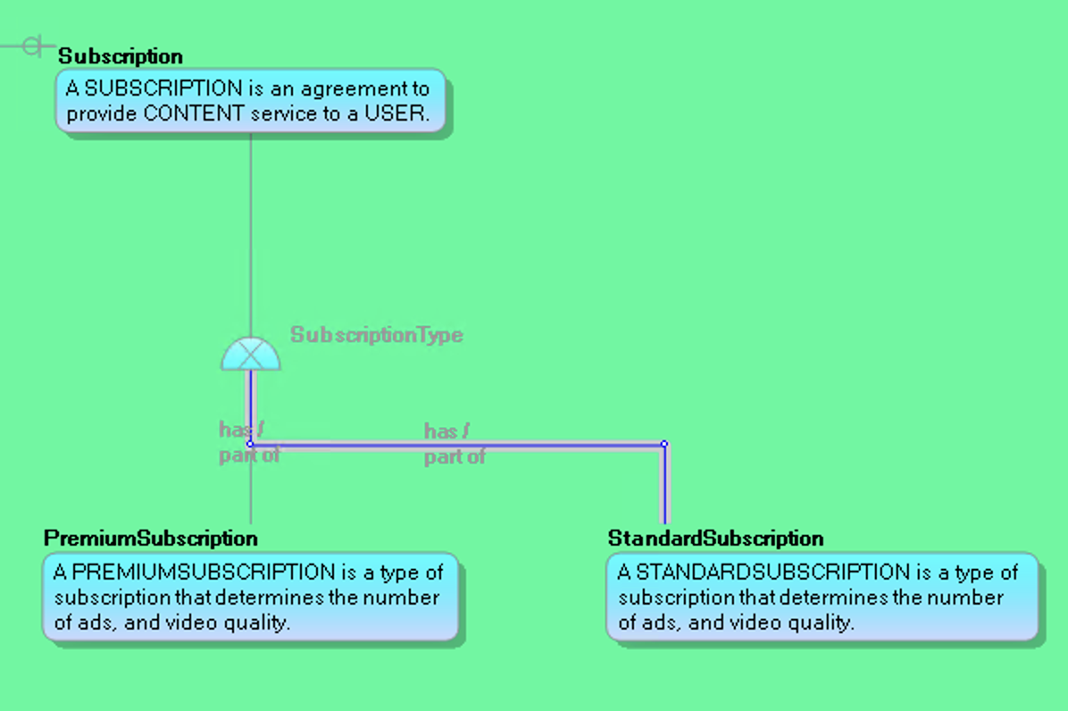
Service subject area (CDM)

Slide 34
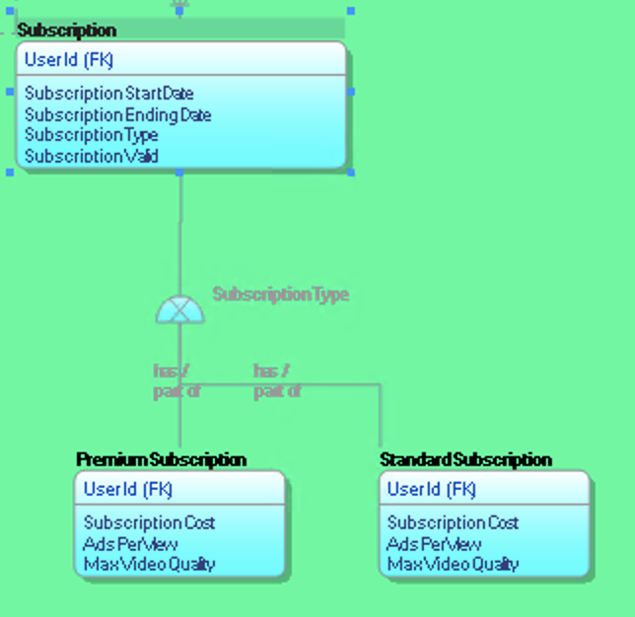
Service subject area (LDM)

Slide 35
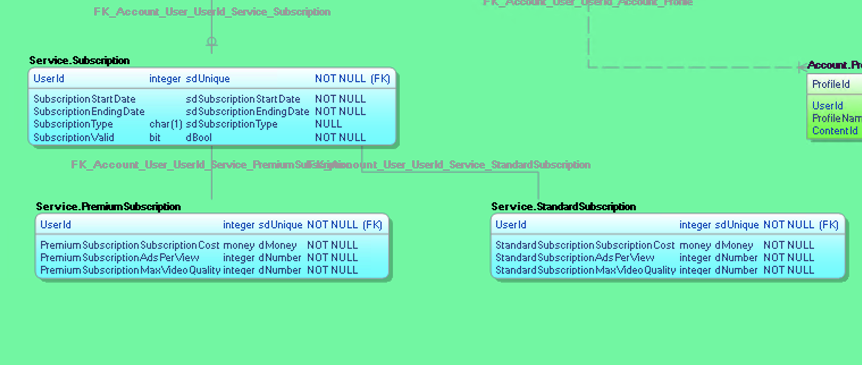
Service subject area (PDM)

Slide 36
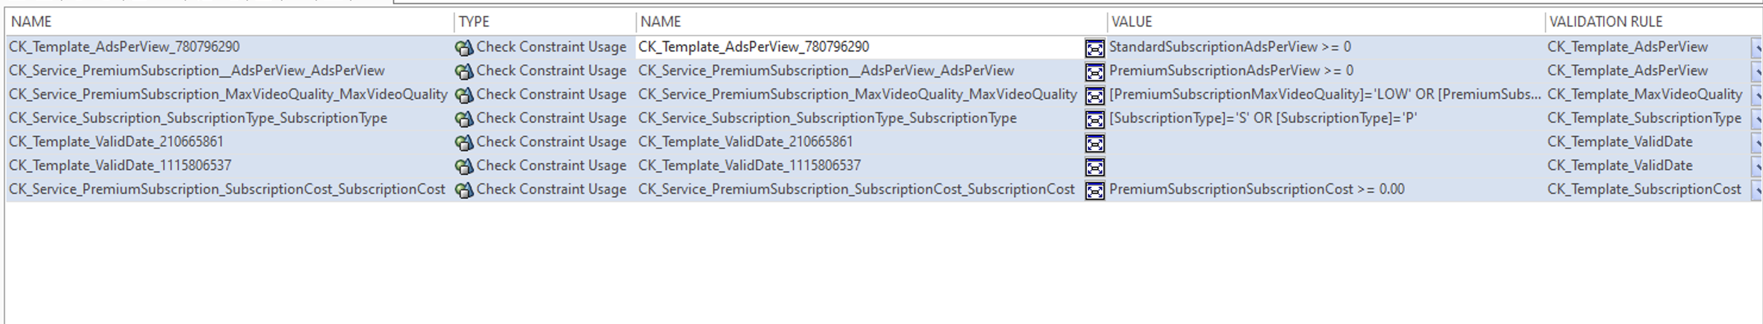
Constraints and Default Values for Service Subject area

Slide 37
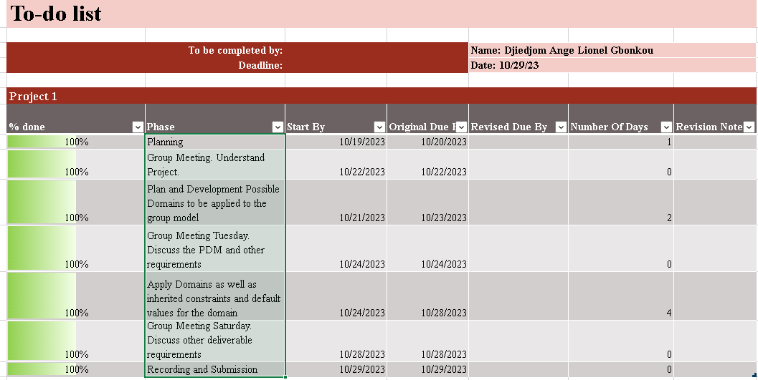
To-do List (Djiedjom Ange Lionel Gbonkou)

Slide 38
Name task

